Slide 1


E-Commerce Customer Behavior & Sales Analysis Project
This presentation will explore the insights gained from an analysis of customer behavior and sales data in an e-commerce platform.
by Arindam Adhikari

Slide 2



Project Platform & Tools
Jupyter Notebook: Used for data analysis and visualization. Allows interactive code execution, making it ideal for exploring datasets and generating insights.
MySQL: A powerful relational database management system, employed to store and manage the cleaned data effectively.
Excel: Utilized for data manipulation and creation of informative charts and graphs to visually represent key findings.

Slide 3
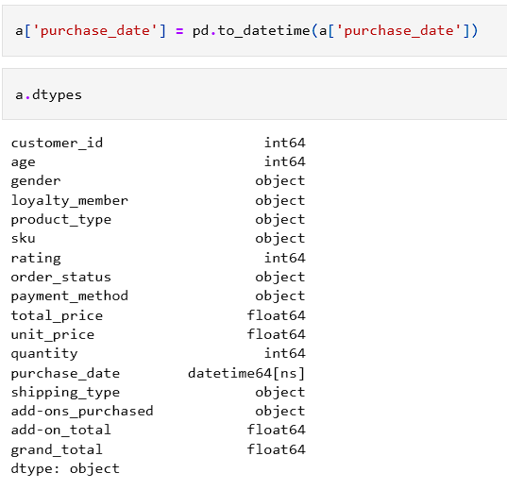
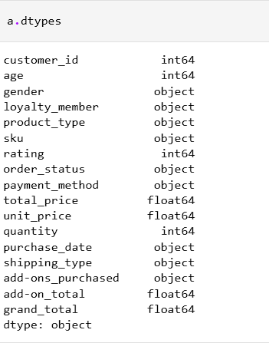
Data Ingestion & Preparation
Import necessary libraries:
Load data from a CSV file:
import pandas as pd
import numpy as np
a = pd.read_csv(r'C:\Downloads\sale.csv')
Change date type

Slide 4
MySQL Integration
Importing Cleaned Data: Transferring the preprocessed data from the Pandas DataFrame into the MySQL database for efficient querying and analysis.
Database Analysis: Leveraging the power of SQL to extract, transform, and load data from the MySQL database, enabling in-depth analysis of customer behavior and sales trends.

Slide 5
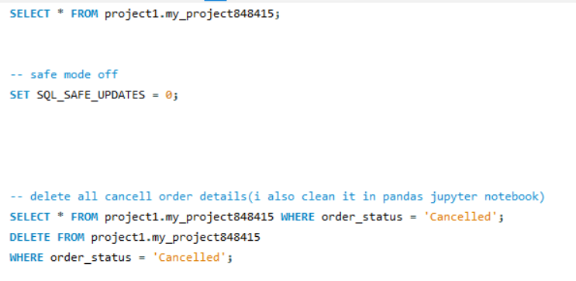
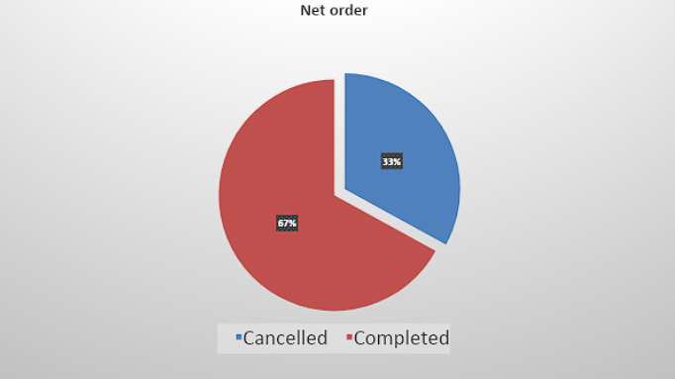
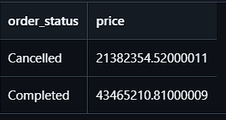
Order Fulfillment Analysis
Cancellations vs. Completed Orders: Analyzing the rate of order cancellations compared to completed orders. This helps identify potential areas for improvement in the order fulfillment process.
Data visualized by excel

Slide 6

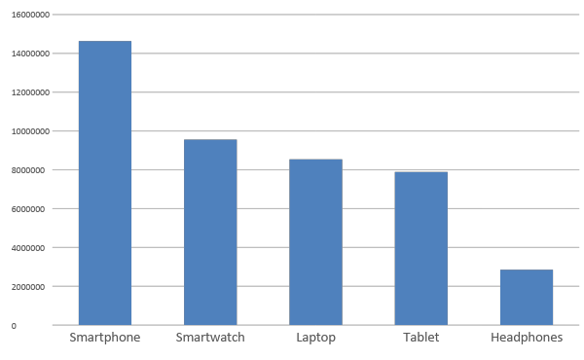
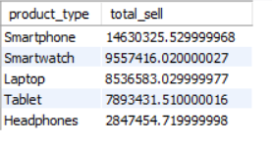
Segment-Specific Sales Leaders
Top 5 Products per Market Segment: Identifying the best-selling products within different market segments, such as electronics goods.

Slide 7
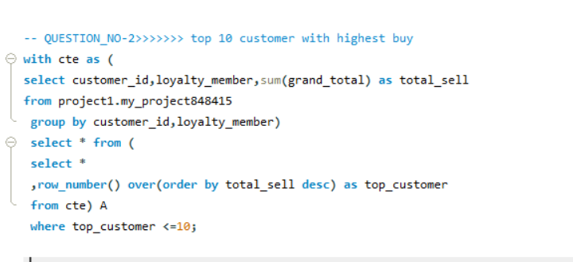
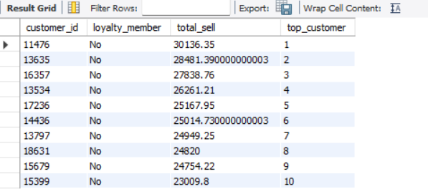
Top 10 customer with highest buy

Slide 8
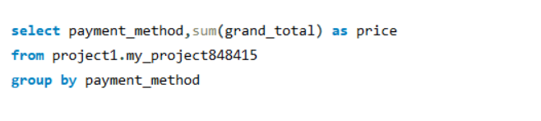
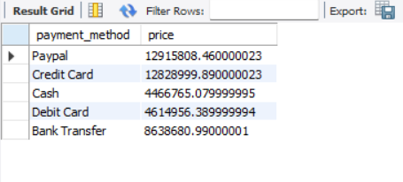
Payment Method Performance
Revenue Breakdown by Payment Gateway: Analyzing the revenue generated through different payment methods, such as credit cards, debit cards, or mobile wallets.

Slide 9
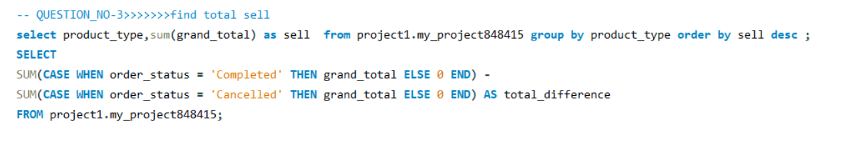
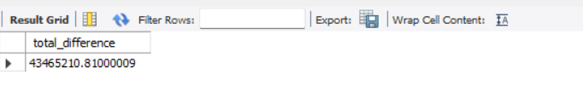
Total revenue generated
Identifying High-Growth Segments: Analyzing the sales growth of different market segments over time, identifying areas with significant potential.

Slide 10

ANALYSIS:
Smartphone and Smartwatch
are the two most popular product categories of selling,
showing that people done their payment from “PayPal" and “Credit Card" the most.
INSIGHT
Segment-Wise Performance: Smartphone is the top buying segment in this sale
:Sales Trends : Credit Card is the emerging payment method in the upcoming day
Opportunities for Growth: Laptops and credit cards are emerging as the most profitable product and payment method, respectively, in the coming days.
Summary

